Slide 1
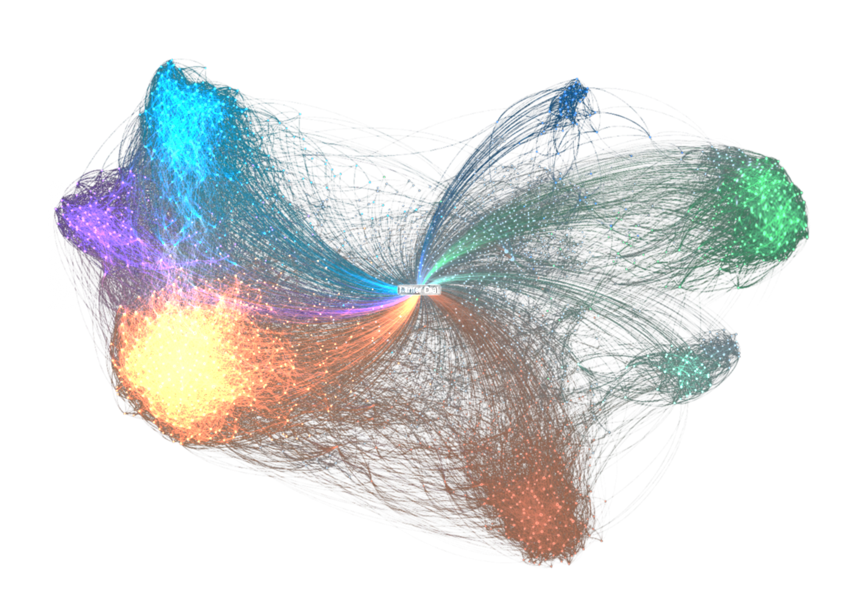
I N T R O D U C T I O N T O
V I S U A L
QUESTION ANSWERING
沈昇勳
Sheng-syun Shen

Slide 2
Outline
Classical Question Answering
End-to-End Viausal Question Answering
Attention Model on Question Answering
Libraries and Toolkits
VQA

Slide 3
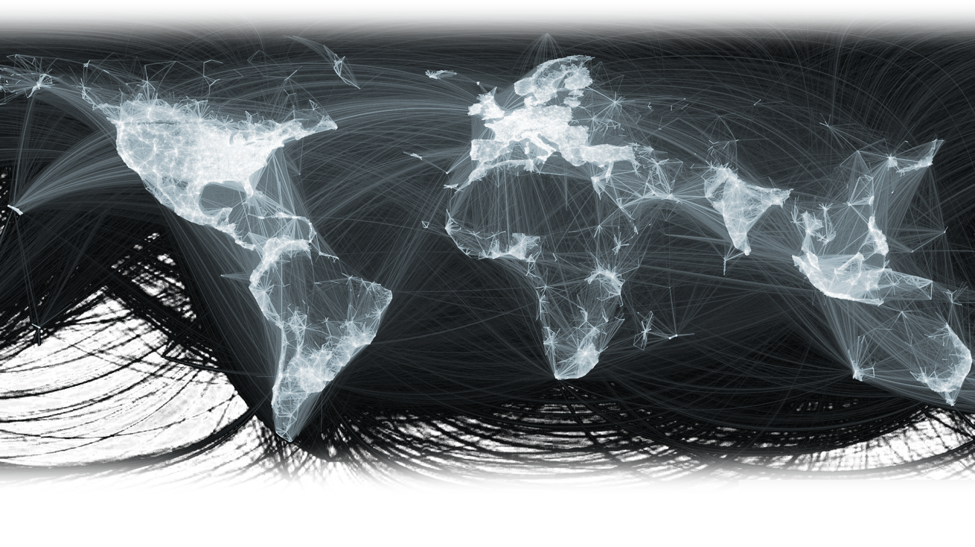
Classical Question Answering
VQA

Slide 4
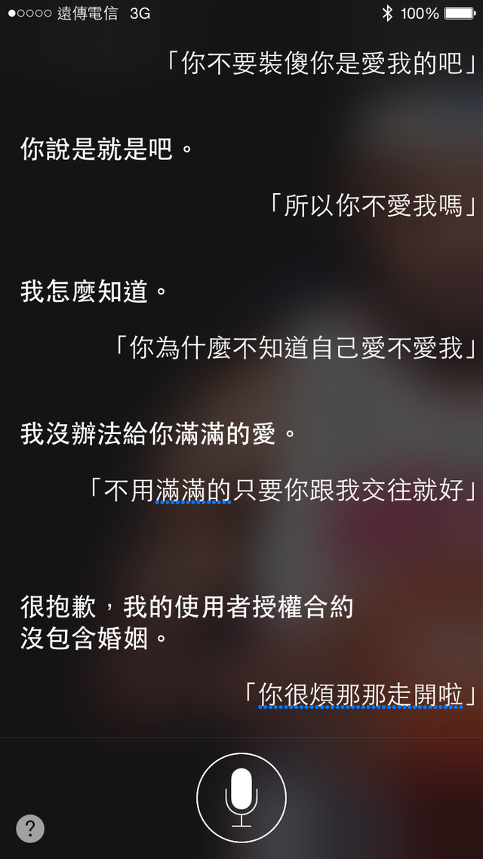
Question Answering
One of the oldest NLP tasks.
Apple Siri
VQA

Slide 5
Types of Questions in QA Sysyem
Factoid questions
Where is Apple Computer based ?
How many calories are there in two slices of apple pie ?
Complex (Narrative) questions
In children with an acute febrile illness, what is the efficacy of acetaminophen in reducing fever ?
VQA

Slide 6
Approaches for Solving QA
IR-based approaches (Information Retrieval)
TREC; IBM Watson; Google
Knowledge-based and Hybrid approaches
Apple Siri; Wolfram Alpha
VQA

Slide 7
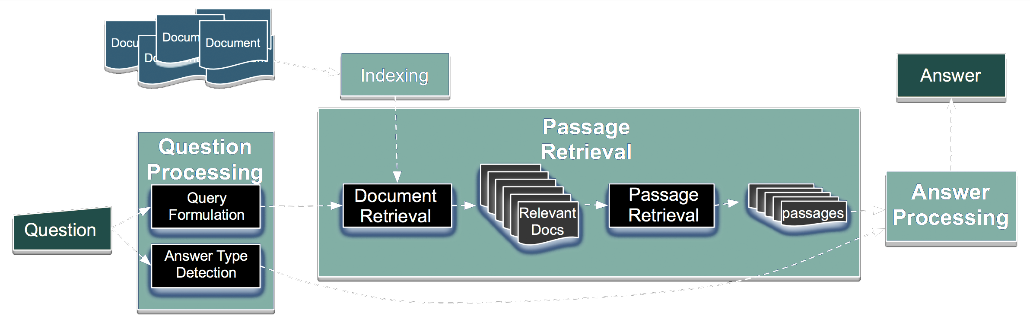
IR-based Factoid QA
VQA

Slide 8
IR-based Factoid QA
Question processing
Detect question type, answer type
Formulate queries to send to a search engine
Passage retrieval
Retrieve ranked documents
Break into suitable passages and rerank
Answer processing
Extract candidate answers
Rank candidates
VQA

Slide 9
IR-based Factoid QA | Question Processing
Answer type detection
Decide the named entity type (person, place) of the answer
Query formulation
Choose query keywords for the IR system
Question type classification
Is this a definition question, a math question, a list question
VQA

Slide 10
IR-based Factoid QA | Question Processing
Answer type detection : Name entities
Who founded Virgin Airlines ?
PERSON
What Canadian city has the largest population ?
CITY
VQA

Slide 11
End-to-End
Viausal Question Answering
VQA

Slide 12
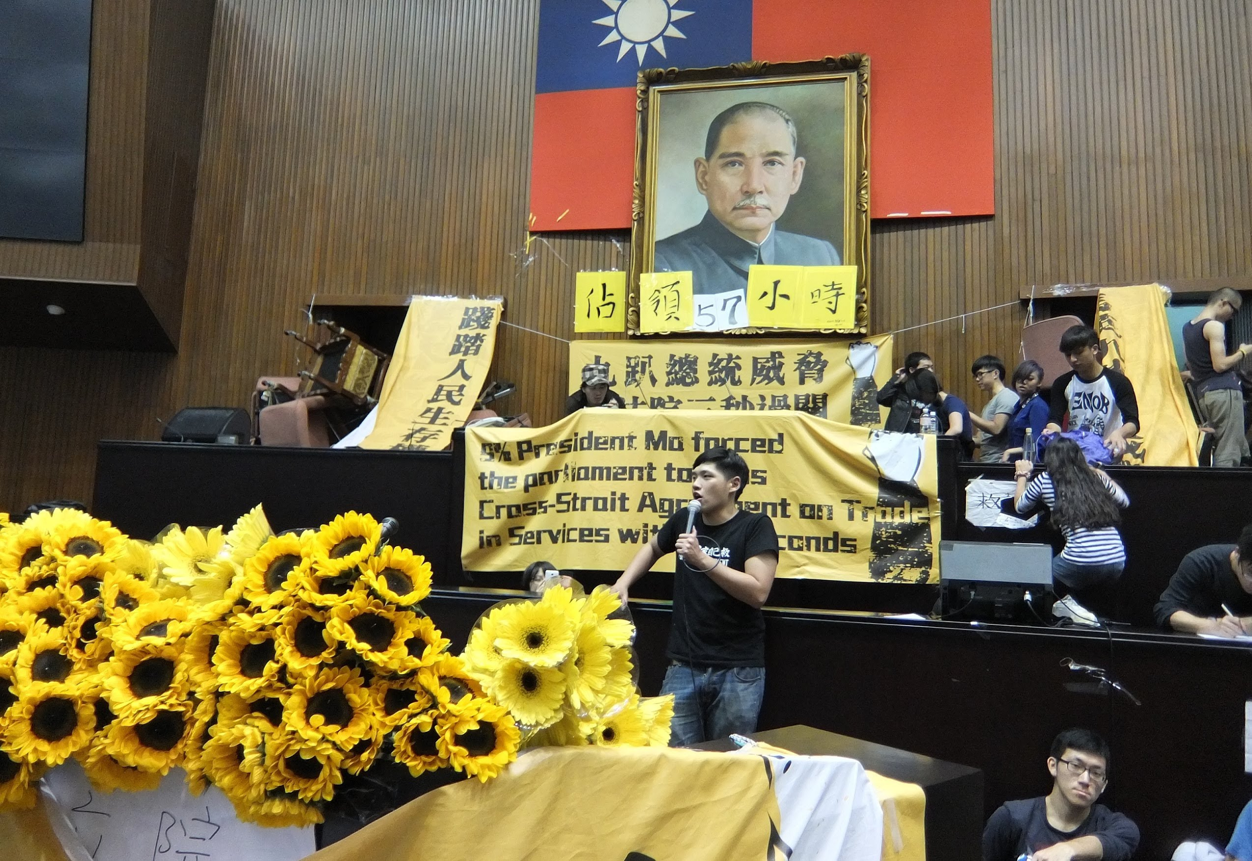
Visual QA may contain some sub-problems...
Object detection
Image segmentation
Some Question Answering techniques
Question type classification
Answer type detection
Is there any banana in the picture ?
(A) Yes. (B) No.
VQA

Slide 13
End-to-End Visual QA
Can directly predict answers according to questions and images
VQA

Slide 14
Proposed approach
TRAINING
Neural
Network
Feature Vector : Question
Feature Vector : Answer
VQA

Slide 15
Proposed approach
TESTING
Multiple Choices
(A)
(B)
Evaluating by
Cosine-Similarity
(C)
(D)
(E)
Result
VQA

Slide 16
Extract Feature Vectors | Word Embedding
With a view to understanding sentences or documents, we need to model them in fixed-length vector representation.
Basic Representation Method :
Bag-of-words model / N-hot encoding
Each document is represented by a set of keywords
A pre-selected set of index terms can be used to summarize the document contents
VQA

Slide 17
Extract Feature Vectors | Word Embedding
Bag-of-words model / N-hot encoding
Definition
The pre-selected vocabulary V = {k₁,...,k_{i}} is the set of all distinct index terms in the collection
Examples
V = {John,game,to,likes,watch}
Sentence 1 S₁ = [1,0,1,2,1]
John likes to watch movies. Mary likes movies too.
Sentence 2 S₂ = [1,1,1,1,1]
John also likes to watch football games.
VQA

Slide 18
Extract Feature Vectors | Word Embedding
Bag-of-words model / N-hot encoding
Property
Simple and Powerful
Problem :
lose the ordering of the words
ignore the semantics of the words
Father = [0 0 0 0 0 1 0 0 … 0 0 0 0]
Mother = [0 0 1 0 0 0 0 0 … 0 0 0 0]
the cosine similarity between these two terms :
= 0 ?!
WTF
VQA

Slide 19
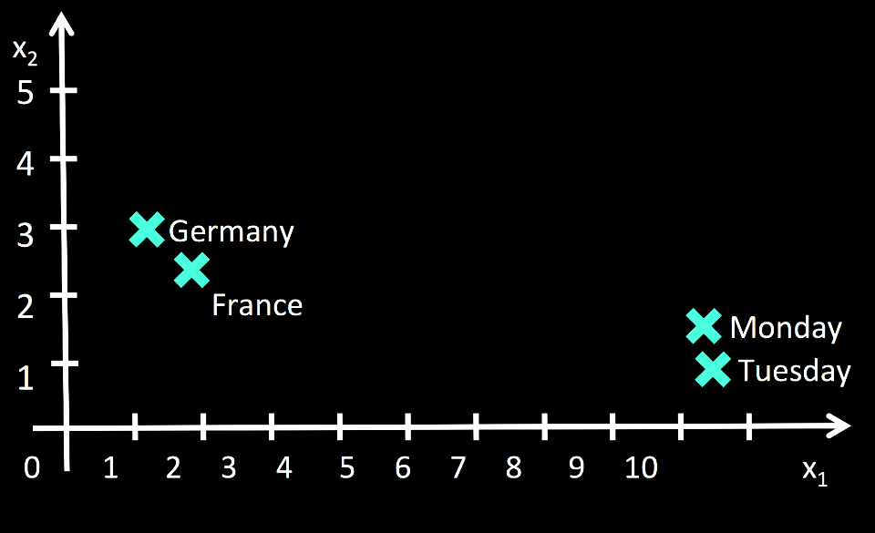
Extract Feature Vectors | Word Embedding
While word-embedding can solve these problems :
Words are represented as a DENSE, FIX-LENGTH vector.
Preserve semantic and syntatic information.
VQA

Slide 20
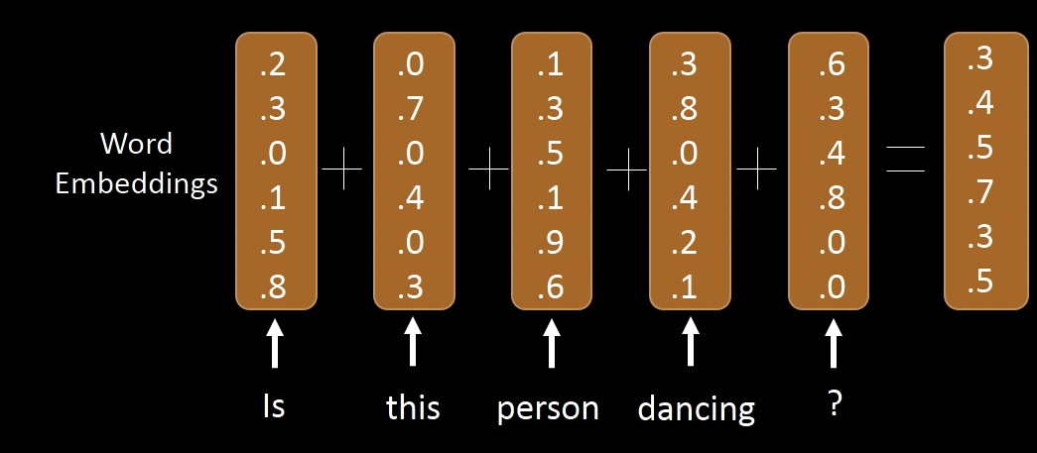
Extract Feature Vectors | Word Embedding
Using this technique, we can then represent phrases, or sentences by :
Averaging word vectors
Adapting sentence-embedding
https://cs.stanford.edu/~quocle/paragraph_vector.pdf
VQA

Slide 21

Extract Feature Vectors | Image Embedding
Using a Pre-trained CNN model, we can classify images
VQA

Slide 22
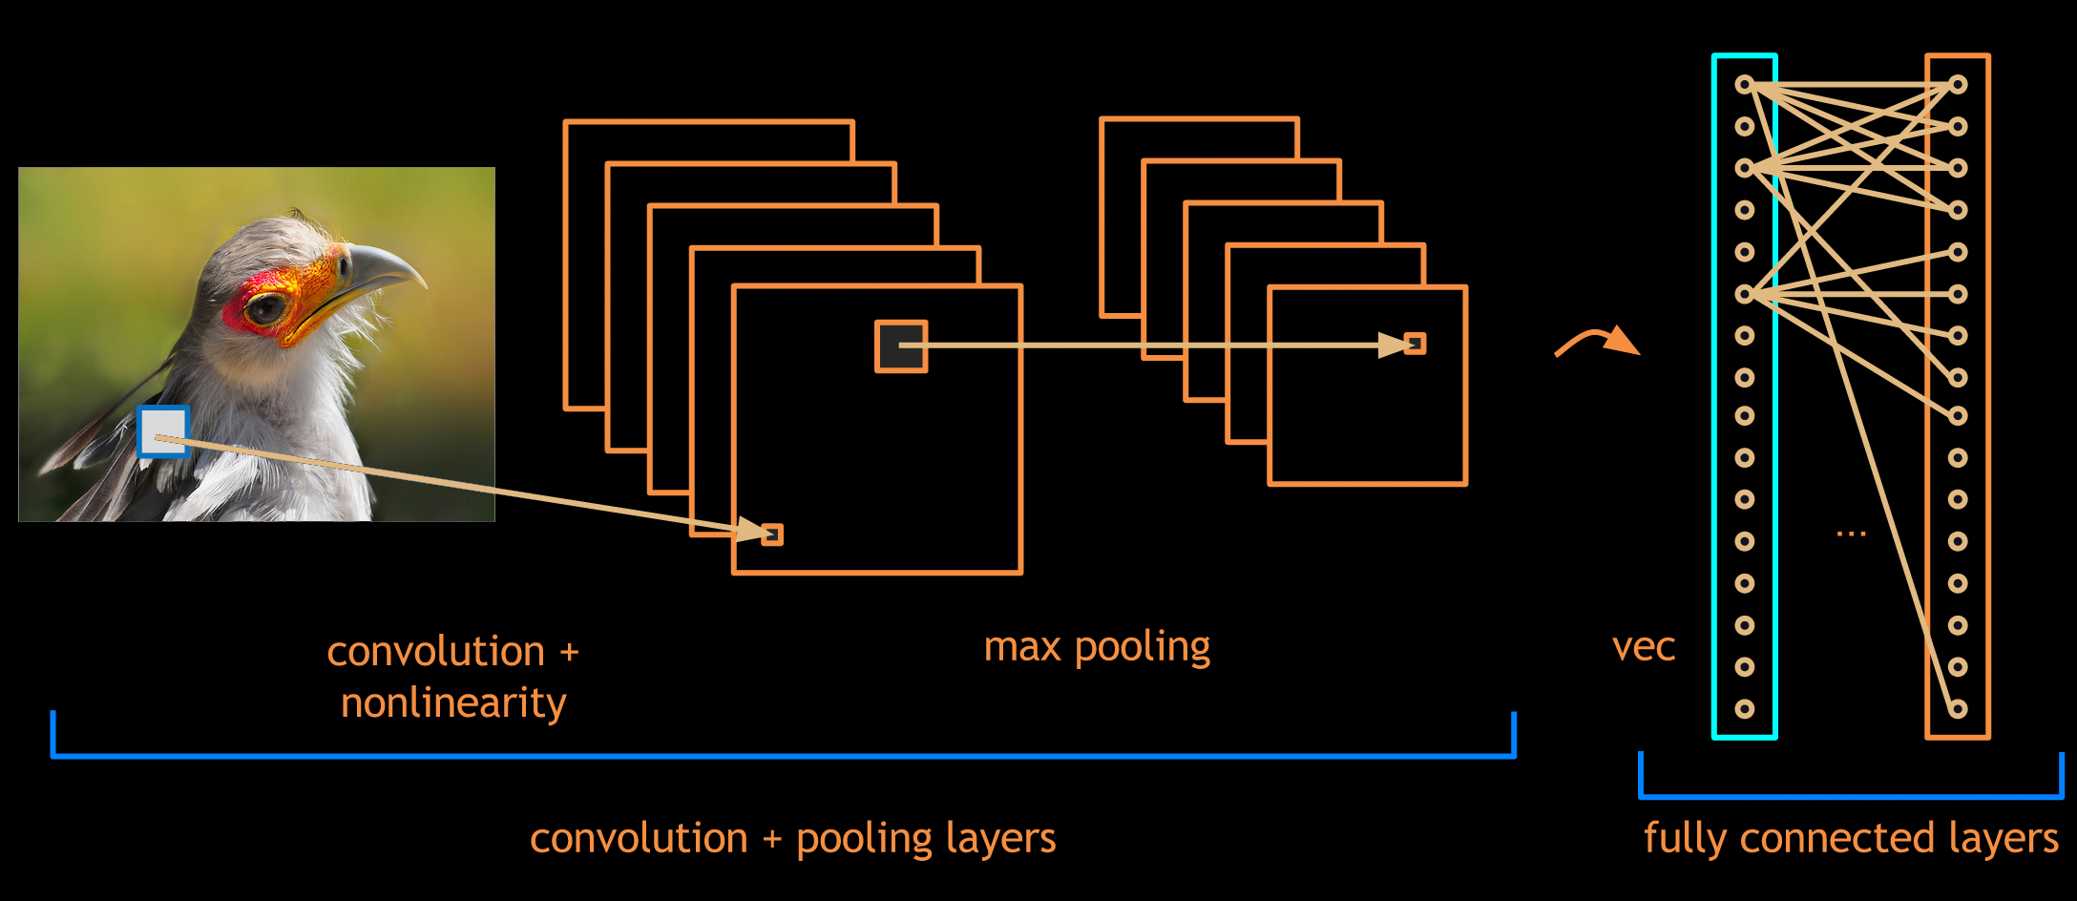
Extract Feature Vectors | Image Embedding
We can also represent images in vector-form by feeding them into the pre-trained CNN models
VQA

Slide 23
Proposed approach
Neural
Network
Image + Word Embedding
Word Embedding
Feature Vector : Question
Feature Vector : Answer
VQA

Slide 24
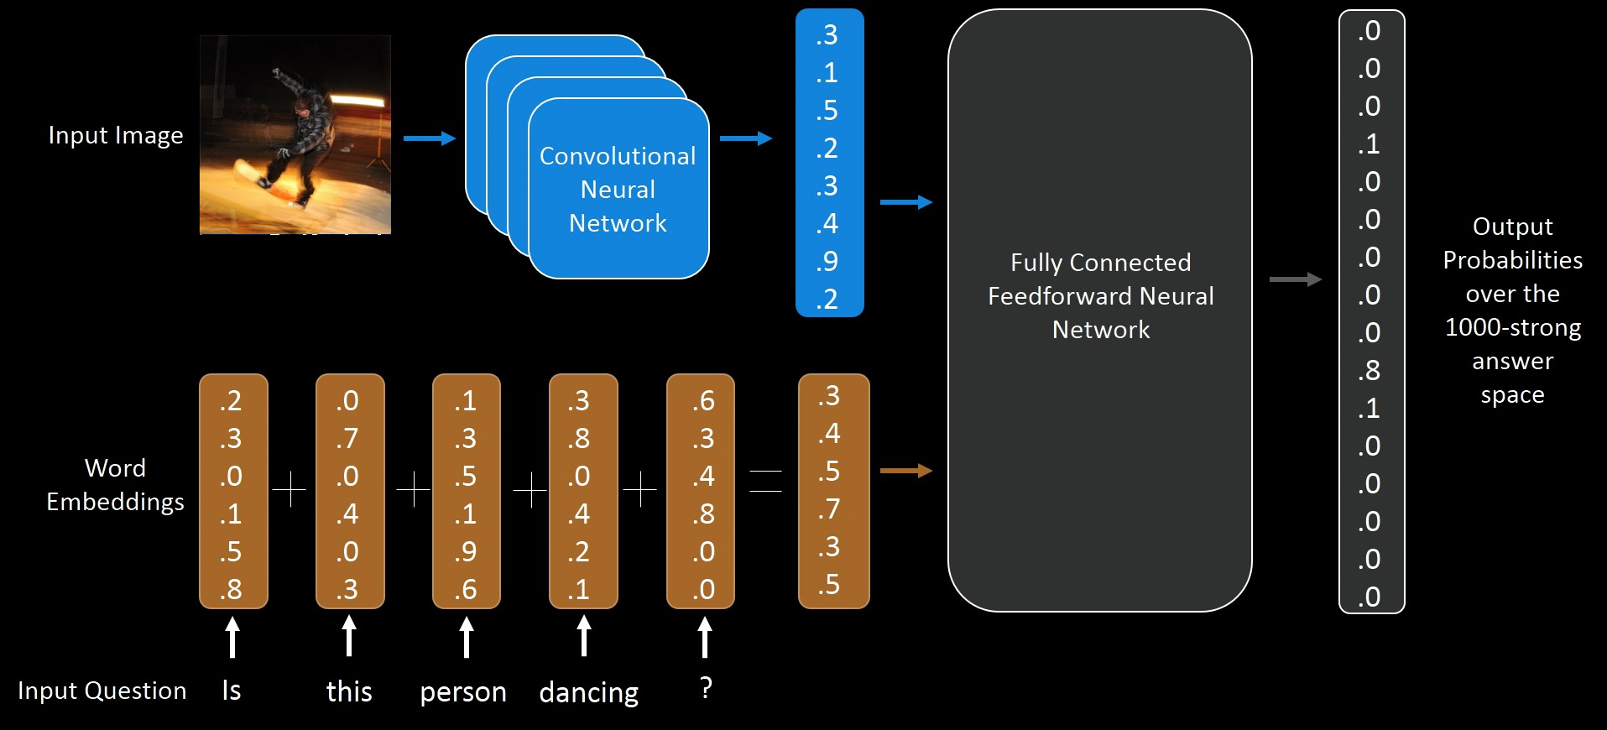
Proposed approach
VQA

Slide 25
Proposed approach
References for implementation :
https://avisingh599.github.io/deeplearning/visual-qa/
http://www.cs.toronto.edu/~mren/imageqa/
https://www.d2.mpi-inf.mpg.de/sites/default/files/iccv15-neural_qa.pdf
VQA

Slide 26
Variations
BOW
“Blind” model. BOW+logistic regression
LSTM
Another “Blind” model.
IMG
CNN feature without question sentences but question type.
VQA

Slide 27
Attention Model on
Question Answering
VQA

Slide 28
Discussion
How to use image information precisely ?
VQA

Slide 29
Reference Paper
Xu, Huijuan, and Kate Saenko.
UMass Lowell
Ask, Attend and Answer: Exploring Question-Guided Spatial Attention for Visual Question Answering.
arXiv preprint arXiv:1511.05234 (2015).
VQA

Slide 30
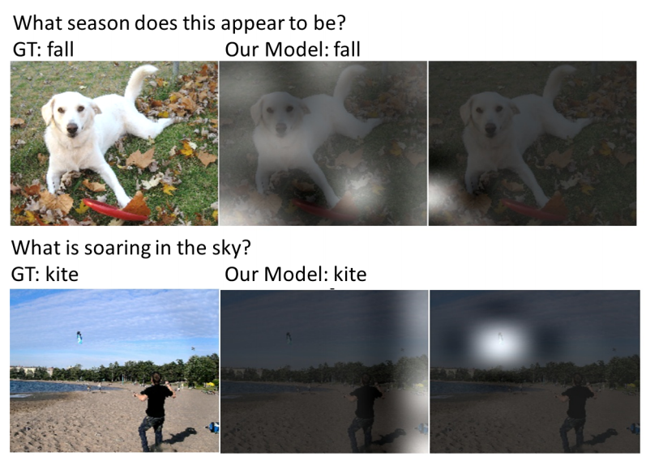
Samples in this paper
VQA

Slide 31
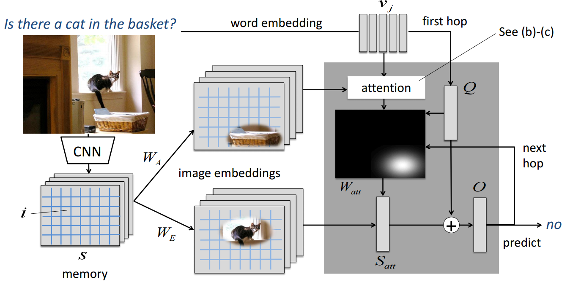
Proposed Methodology
VQA

Slide 32
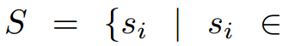
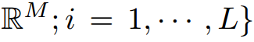
Proposed Methodology
CNN features :
extract the last convolutional layer of GoogLeNet
Si
VQA

Slide 33
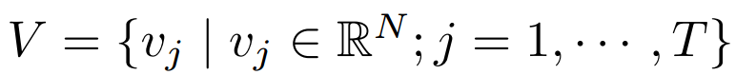
Proposed Methodology
Text features :
extract the last convolutional layer of GoogLeNet
VQA

Slide 34
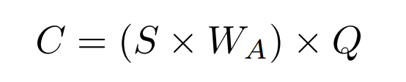
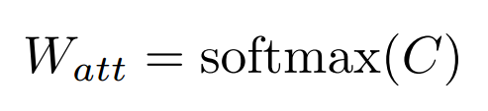
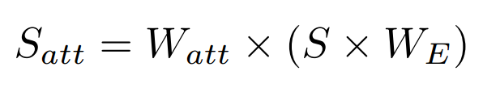

Proposed Methodology | Attention Level
Sentence (Question) Attention
Attention Matrix : W_{A}
C: R^{L}, S: R^{L×M}, W_{A}: R^{M×N}, Q: R^{N}, W_{att}: R^{L}, W_{E}: R^{M×N}
VQA

Slide 35
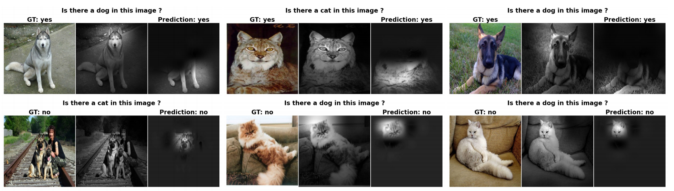
Attention Analysis
Object Presence
VQA

Slide 36
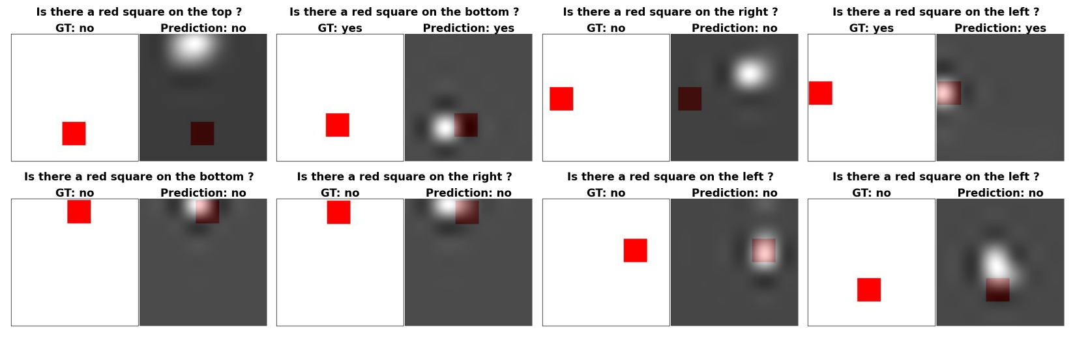
Attention Analysis
Absolute Position Recognition
With/O : 100% vs 75%
VQA

Slide 37
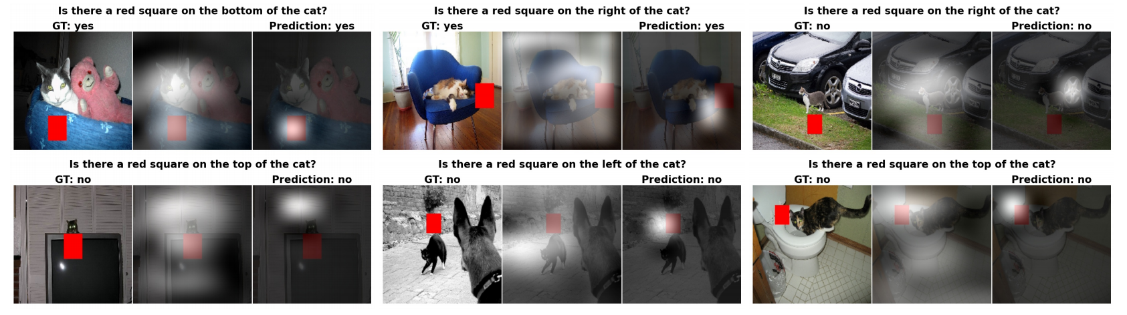
Attention Analysis
Relative Positition Recognition
With/O : 96% vs 75%
VQA

Slide 38
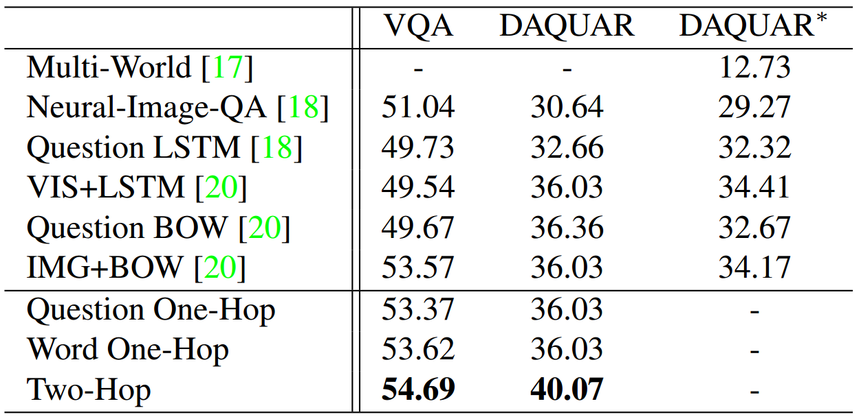
Experimental Result
VQA

Slide 39
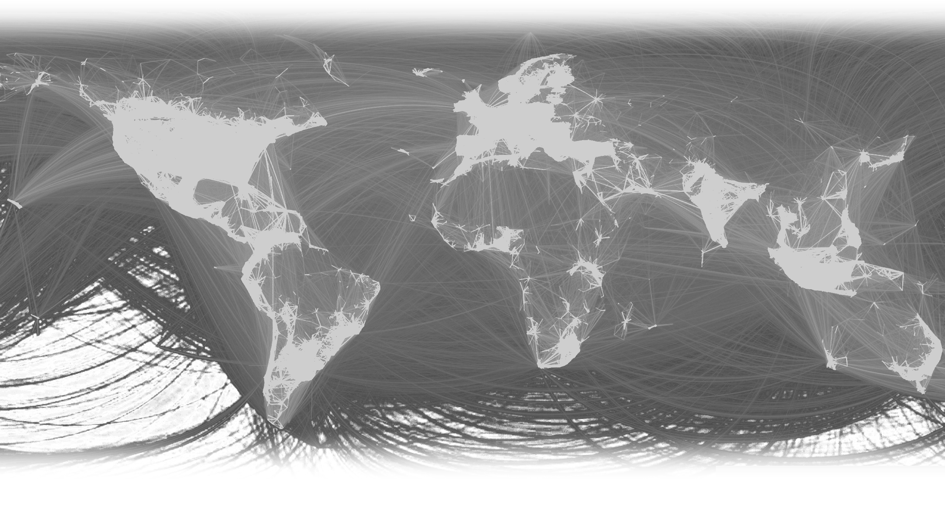
Libraries and Toolkits
VQA

Slide 40
Word Embedding
Word2Vec
https://code.google.com/p/word2vec/
GloVe
http://nlp.stanford.edu/projects/glove/
Sentence2vec
https://github.com/klb3713/sentence2vec
VQA

Slide 41
Image Embedding
An pre-extracted feature set is provided :
http://cs.stanford.edu/people/karpathy/deepimagesent/coco.zip
This is the web page. Hope it works for you :
http://cs.stanford.edu/people/karpathy/deepimagesent/
( It’s about generating image descriptions. )
VQA

Slide 42

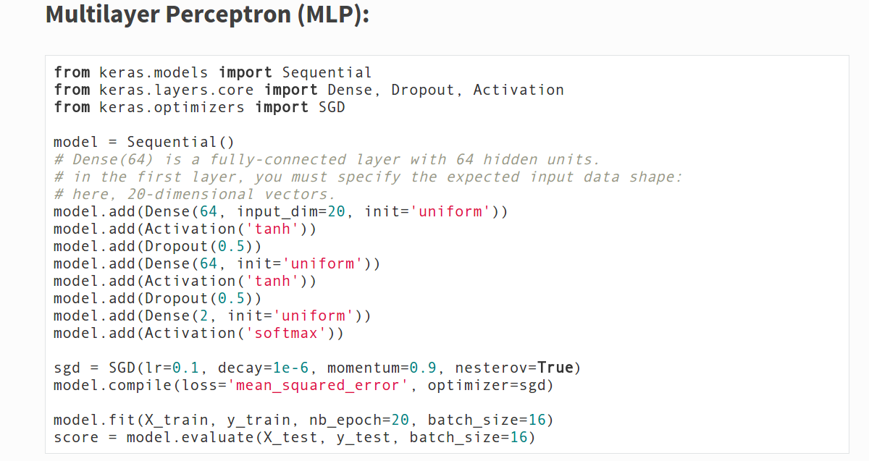
Keras
Website and documentation : http://keras.io/
Example :
VQA

Slide 43
Keras
Notification :
If input features are too large for you, you can load them in batch, and apply batch learning as well.
Here are some examples :
https://github.com/avisingh599/visual-qa/blob/master/scripts/trainMLP.py
VQA

Slide 44
References
VQA

Slide 45
References
https://web.stanford.edu/class/cs124/lec/qa.pdf
懶得寫了
VQA

Slide 46
The End
Thanks for your listening
VQA

